Slide 1
ETL Concepts Part 1
ETL 101 Series
Anupama Putcha
Notes:
Hi, I am Anupama, from the BTS – Datawarehousing practice.
Today I will take you through the ETL concepts Part I module.
The module covers the basics of ETL concepts.
So let us begin our session understanding what ETL is.
The Target Audience are:
Team Rainbow (TRB) associates aligned to Datawarehouse- Business Intelligence practice after Induction training and
Associates who have newly joined Datawarehouse- Business Intelligence practice without prior DWH implementation experience
© 2009 Wipro Ltd – Internal & Restricted
‹#›

Slide 2
ETL Concepts Overview
Data Integration is the process of transforming business data from different applications to provide users with a unified view of data.
Need for Data Integration has increased as the volume and the need to share existing data in disparate sources explodes with mergers, acquisitions, global operations etc.
Extract – Transform – Load (ETL) is the foundation of a Data Integration system.
The ETL details are covered in two parts,
Part 1 – Overview, Data Analysis and Process Flows.
Part 2 – Extraction, Transportation and Loading, and Error Handling
Notes:
Before we get into ETL, let us understand what Data Integration is.
Businesses usually have a huge number of systems, processing data, for different applications serving various business units.
Data Integration is the process of transforming business data from different applications to provide users a unified view of data.
As businesses grow and diversify globally, the volume and the need to share existing data in disparate sources increases exponentially.
This is where the need for Data Integration comes in.
Extract – Transform – Load or ETL as the acronym goes is the foundation of a Data Integration system.
The ETL details are covered in two parts,
This presentation is part 1 of the series
In Part 1 , ETL Overview, Data Analysis and Data Integration Process Flows are covered
In Part 2, ETL Extraction, Transportation and Loading, along with Error Handling are covered
© 2009 Wipro Ltd – Internal & Restricted
‹#›

Slide 3
ETL Concepts Objectives
Upon completion of this module you will be able to:
Understand what is a ETL system
Identify different source and target systems
Know different types of DI Process Flows
Notes:
In this module the components involved in an ETL process are covered along with the interaction with different systems,
and the different Data Integration process flows that can be implemented using ETL.

Slide 4
ETL Concepts Outline
Lesson 1 Overview
Lesson 2 Data Analysis
Lesson 3 Process Flow
Notes:
This module has 3 lessons.
ETL Overview, Data analysis during the process and Data Integration Process flows

Slide 5
Overview
Notes:
Let us start by understanding ETL and the different ETL processes.
ETL as we saw earlier is acronym for Extract , Transform and Load.

Slide 6
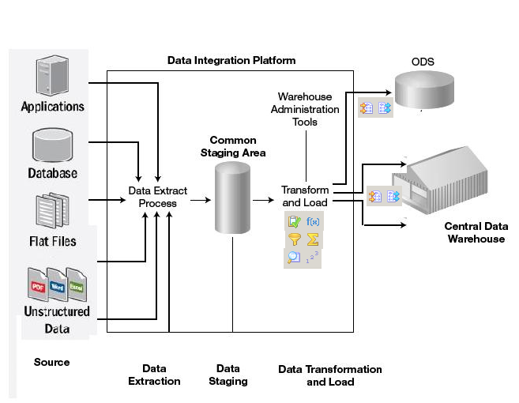
ETL Overview
Extracting data from many disparate, heterogeneous systems
Transforming the data into unified data format
Loading the data into a data warehouse or any other target database / application
Notes:
Imagine a business, having departments maintaining the relevant data, each in different formats, using their own applications. Now if the business wants to have a unified view of the data from all these departments, they would have to implement data integration process to combine data from these applications to get a unified view.
As we saw, ETL or Extract – Transform - Load is the foundation of a Data Integration system.
Lets look into what these 3 processes actually mean.
“Extract” corresponds to Extracting Data
This includes extracting data from disparate systems, for the purpose of data Integration.
Data extraction ranges from simple extracts (like flat files) and loads, to complex captures of changed data and updates to the targets.
“ Transform” corresponds to Transforming the extracted data.
The data in Data Integration system is usually populated from multiple heterogeneous source systems, that follow their own rules, formats and conventions. Thus, it is required to reconcile the data in an appropriate,unified format. The transformation step in building the Data Warehouse achieves this reconciliation and unification.
“Load” corresponds to loading the Transformed data into the identified target system.
After data undergoes transformation, it can be loaded onto the target system as per the requirements.
The firgure was prepared Manually with Individual items taken from various sources

Slide 7
Data Processing during ETL
Integrating data
Deriving Data
Filtering data
Aggregating data
Cleansing Data
Validating Data
Notes:
What exactly happens, with the data during ETL ?
Data processing may include :
Integrating data i.e Merging data from a range of source databases and computing platforms into a desired format.
Deriving Data i.e Applying formulae on source fields to adhere to the various business needs.
Filtering data usually means Removing unwanted fields / data from sources before moving into destination.
Aggregating data i.e Computing aggregations and other derived data based on the new data.
Cleansing Data refers to the process of Verifying and Correcting data before loading onto destination system.
Validating Data includes Validating the incoming data against information which already exists in the target database tables.

Slide 8
Data Analysis
Notes:
In a Data Integration flow, there would be sources and targets.
This section explains, the typical sources and targets used in DI and the considerations done while identifying them.

Slide 9






Typical Sources
Transactional Data Source
Internal Data Source
Archived Data Source
External Data Source
Common data source formats :
Notes:
A business gets data in a lot of logical and physical formats. Logically, data from these sources can be considered as
Transactional Data: This category of data comes from various operational systems of the enterprise like sales module or customer module etc
Internal Data: This is organization’s internal data like “private” spreadsheets, documents, customer profiles etc.
Archived Data: Archived data comes from archived files. In every operational system, the old data is periodically taken and stored in archived files.
External Data: This category of data comes from external agencies to use market share data of the different competitors.
These data would be available in different physical formats as well.
Common data source formats are flat files, spreadsheets, XML, relational databases, unstructured data like pdf files etc.
The Source of the Figure is Informatica User Guide Manual.
© 2009 Wipro Ltd – Internal & Restricted
‹#›

Slide 10
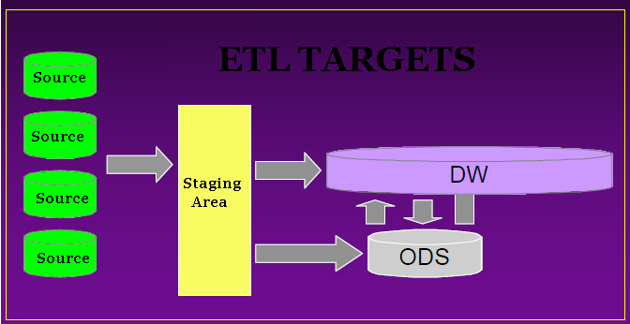
Typical Targets
Staging Area
Operational Data Store (ODS)
Data Warehouse
Notes:
In a DI process, depending on the requirement, Data after transformation is typically loaded into one of the following type of targets.
Data Staging Area
ODS (Operational Data Store)
Data Warehouse
We will look at these in detail over the next few slides
Source of Figure : It has been prepared manually.

Slide 11
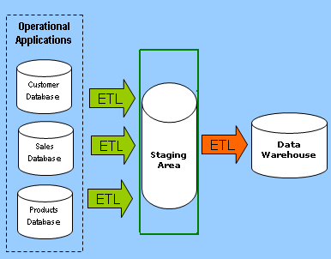
Staging Area
Area where data from multiple sources are pulled and stored before further processing.
Data staging provides a place and an area with a set of functions to
- Clean
- Change
- Combine
- Convert
- Eliminate duplication
- Prepare source data for storage.
Notes:
The Staging Area is a temporary location where data from multiple source systems is copied and stored. It refers to a dedicated disk space, temporary and permanent work files and databases.
This staging area serves many purposes
Firstly, the data is most consistent with the source. It is devoid of any transformation or has only minor format changes.
Secondly, The staging area in a relation database can be read or scanned or queried using SQL without the need of logging into the source system or reading files (text/xml/binary).
Finally, It is a prime location for validating the quality of data from the source or auditing and tracking down the data issues.
For e.g as shown in the diagram, We have data coming in from Customer / Sales and Products Transactional databases which are hosted on multiple physical databases. Before we join the data, to get a unified view, we have to make sure that we have correct / clean data from all the sources. This is mainly done to prevent connecting to the transactional databases repeatedly, in the event of an issue during processing.
Once the data is cleansed, it’s pulled into the staging area as is and then used for further processing.
Source of the Figure : It was Prepared manually

Slide 12
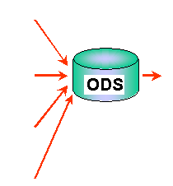
ODS (Operational Data Store)
Designed to Provide integrated, collective information for the operational environment.
Subject-oriented
Integrated
Volatile
Current— no history
Notes:
ODS
The Operational Data Store(ODS) is designed to provide an integrated and collective information for the operational environment. Updates can be done on the ODS and it usually contains the current information.
An ODS is
Subject-Oriented : as it provides a simple and concise view of a particular subject/entity . It is Organized around major subjects, such as customer, product, sales.
Integrated : it is Constructed by integrating multiple, heterogeneous data sources Like relational databases, flat files, on-line transaction records
Volatile : Data can be updated / corrected after being moved into an ODS
Current : ODS would typically contain data for the current load cycle only.
For e.g. An ODS for a Sales module would contain integrated sales data from different applications for the current date. This can be updated for doing reconciliations.
Architecturally, an ODS is the operational counterpart of the data warehouse. It is also used as an intermediary step before loading data into a Datawarehouse
Source of the Figure: Oracle Datawarehouse Guide

Slide 13
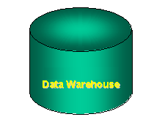
Data Warehouse
A decision support database that is maintained separately from the organisation’s operational database
Support information processing by providing a solid platform of consolidated, historical data for analysis
Subject-oriented
Integrated
Non-volatile (read-only)
Time variant (history).
Notes:
Data Warehouse
The Data Warehouse is a central repository of data, used by business users to perform analysis of historic data and to make informed decisions. Hence Data warehouse, houses large volumes of historical data and is tuned for quick retrieval of information.
It can be described as being
Subject-Oriented : Like an ODS it provides a simple and concise view around particular subject . It is Organized around major subjects, such as customer, product, sales.
Integrated : It is Constructed by integrating multiple, heterogeneous data sources. Like relational databases, flat files, on-line transaction records
Non-Volatile : as compared to the ODS, Operational update of data does not occur in the data warehouse environment
Time Variant : Data warehouse data provide information from a historical perspective (e.g., past 5-10 years)
For e.g. A Datawarehouse for a Sales module would contain integrated sales data from different applications for a period of time. Once data is loaded onto a Datawarehouse, it is used as read only and is typically not updated.
Source of the Figure: Prepared Manually

Slide 14
Data Analysis Aspects
Definition of the data
Data Type
Relationships
Availability
Notes:
While Analyzing data for an ETL process, The following considerations needs to be taken :
Definition of the data. This is to identify the significance of the data. This would help us in applying business rules for transformations.
Data Type. This is helpful in defining datatype in the target or for using functions to convert the data, if there are incompatible ones
Relationship between different sources and their fields. This helps in identifying the various prospects of combining various sources.
Data availability. For each source, latest data might be available at different times. This would affect the schedule of the ETL load.
© 2009 Wipro Ltd – Internal & Restricted
‹#›

Slide 15
DI Process Flow
Notes:
We move on to the final part of the module.
This includes the different process flows that can be used during DI process.
The choice of process depends on the database being used, the processing being done, the sources involved, the number of sources and the volume of data.
© 2009 Wipro Ltd – Internal & Restricted
‹#›

Slide 16
DI Process Flow types
TRANSFORM THEN LOAD
LOAD THEN TRANSFORM
TRANSFORM WHILE LOADING
Notes:
The common DI process flow is classified into three main categories:
• TRANSFORM THEN LOAD which involves ETL processing outside the database.
• LOAD THEN TRANSFORM which involves Loading data into a database staging area for ETL processing.
• TRANSFORM WHILE LOADING which involves ETL processing while loading the data.

Slide 17
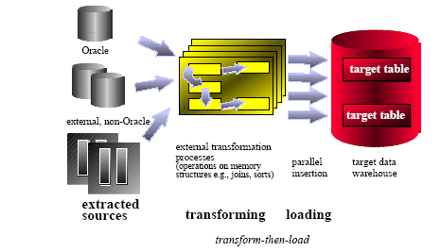
TRANSFORM THEN LOAD
The data is manipulated outside the database to cleanse and sort it, with the result loaded into the database
Notes:
TRANSFORM THEN LOAD - ETL processing outside the database
Most of the transformations and data cleansing is done outside the database, in separate standalone ETL engines/processes.
These engines work with various data sources, trying to integrate them for the necessary ETL steps.
If existing data in the target database is required, e.g., for data cleansing or ID lookup, the target database is treated like, any other external data source involved in the ETL process.
Many of the required exercises could be addressed with basic SQL capabilities including joins, sorts, string manipulations, and validation of referential integrity.
Source of the Figure: Oracle Datawarehouse Guide

Slide 18
TRANSFORM THEN LOAD
Risks and Disadvantages
External tools used to prepare the data may not scale as effectively as the database does and will cause a bottleneck.
External mechanism has to control ETL process and provide recovery and restart ability
Database capabilities not fully utilized
Notes:
The main risks and disadvantages in this architecture are:
• Scalability for most of the ETL steps has to be provided by an external mechanism outside the database. If the external mechanism fails to scale, there would be a bottleneck.
• Depending on the architecture, the external mechanism has to control the progress of the ETL process and provide recovery and restart functionality for the ETL process.
• Many of these solutions are home-grown, which can be difficult to maintain and extend.
• The database capabilities are not fully utilized.

Slide 19
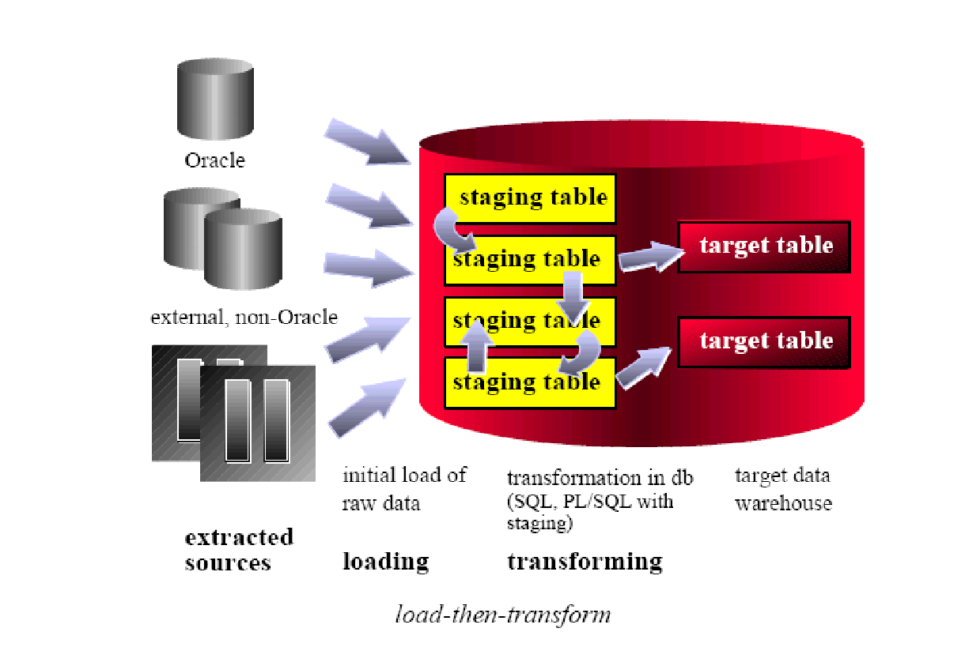
LOAD THEN TRANSFORM
The raw data from the source system is copied into staging tables in the database, where it is cleansed and then loaded into the warehouse tables.
Notes:
LOAD THEN TRANSFORM - Loading into a database staging area for ETL processing
Different sources in various formats reside outside the database. Rather than using an external engine as the single point of control, the database is used.
All the raw data is loaded mostly unchanged in neutral staging structures. If the source systems are relational databases, the staging tables would typically be relational
tables. If the source systems are non-relational, the data may be staged in tables with columns like VARCHAR2(4000) for further processing inside the
database.
After successfully loading the external data unmodified into the database, the transformation steps take place inside the database by running database specific routines, procedures and functions.
Source of the Figure: Oracle Datawarehouse Guide

Slide 20
LOAD THEN TRANSFORM
Risks and disadvantages
Extra disk storage for the staging tables is required. Original raw data from the source systems as well as intermediate data needs to be stored in the Database.
Database Routines might not be optimized to handle all ETL issues easily.
Notes:
The main risks and disadvantages in this architecture are:
• The transformation process stores the intermediate results along with the original raw data from the source systems in the database. So this requires a lot of space on the database.
• Though most of the transformation tasks can be addressed with database functionality like SQL and PL/SQL, these languages might not be optimized to handle
specific ETL issues.
There might be some things which can be done very easily in an ETL tool but requires a lot of coding to do within a database.

Slide 21
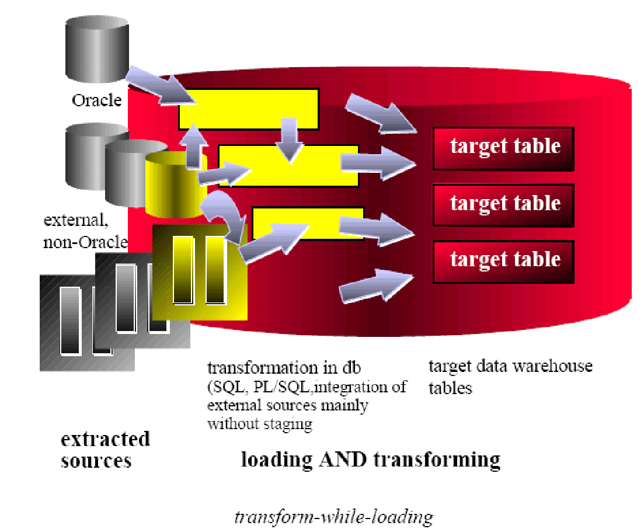
TRANSFORM WHILE LOADING
The raw data is selected directly from a stream of data from the production system or flat files, transformed by applying one or more table functions to it, and then written to the database
Notes:
TRANSFORM WHILE LOADING - ETL processing while loading the data
Now a days database capabilities are significantly enhanced to address, specifically, some of the tasks in ETL environments. The ETL process
flow can be changed dramatically and the database becomes the integrated data transformation engine.
Databases like Oracle, Teradata, Sybase provide transform-while-loading functionality.
Source of the Figure: Oracle Datawarehouse Guide

Slide 22
Module Summary
Congratulations! You have now completed first part the module ETL Concepts
You should now be able to
Understand what is a ETL system
Identify different source and target systems
Know different types of DI Process Flows
Notes:
This course would have helped you to understand about ETL , Identify different source and target systems and have a fair idea about the different types of DI Process Flows
This completes the 1st part of the module on ETL Concepts.
It is now time to take a small quiz to test your understanding.
GOOD LUCK and THANK YOU

Slide 23
Quiz
Notes:
© 2009 Wipro Ltd – Internal & Restricted
‹#›

Slide 24
Question 1
Which of the following can not perform during the ETL process.
Filtering
Reporting
Aggregating
Cleansing
Notes:
© 2009 Wipro Ltd – Internal & Restricted
‹#›

Slide 25
Question 1
Which of the following can not perform during the ETL process.
Filtering
Reporting
Aggregating
Cleansing
Answer : B
Notes:
© 2009 Wipro Ltd – Internal & Restricted
‹#›

Slide 26
Question 2
2. In “Load then Transform” the data transformation happens in ETL Engine ?
True
False
Notes:
© 2009 Wipro Ltd – Internal & Restricted
‹#›

Slide 27
Question 2
2. In “Load then Transform” the data transformation happens in ETL Engine ?
True
False
Answer B
Notes:
© 2009 Wipro Ltd – Internal & Restricted
‹#›

Slide 28
Question 3
3. Which of the following does not describes the ETL data flow.
TRANSFORM THEN LOAD
LOAD THEN TRANSFORM
TRANSFORM WHILE LOADING
TRANSFORM WHILE EXTRACTING
Notes:
© 2009 Wipro Ltd – Internal & Restricted
‹#›

Slide 29
Question 3
3. Which of the following does not describes the ETL data flow.
TRANSFORM THEN LOAD
LOAD THEN TRANSFORM
TRANSFORM WHILE LOADING
TRANSFORM WHILE EXTRACTING
Answer D
Notes:
© 2009 Wipro Ltd – Internal & Restricted
‹#›

Slide 30
Question 4
4. Which statement below is incorrect.
ODS has current data
Data warehouse has historic data
Updates are commonly done on ODS
Updates are common done on Data warehouse
Notes:
© 2009 Wipro Ltd – Internal & Restricted
‹#›

Slide 31
Question 4
4. Which statement below is incorrect.
ODS has current data
Data warehouse has historic data
Updates are commonly done on ODS
Updates are common done on Data warehouse
Answer D
Notes:
© 2009 Wipro Ltd – Internal & Restricted
‹#›

Slide 32
Question 5
5. What does ODS stand for ?
Outside data store
Operational data store
Optional data store
Organization data store
Notes:
© 2009 Wipro Ltd – Internal & Restricted
‹#›

Slide 33
Question 5
5. What does ODS stand for ?
Outside data store
Operational data store
Optional data store
Organization data store
Answer B
Notes:
© 2009 Wipro Ltd – Internal & Restricted
‹#›

Slide 34
References
Notes:
© 2009 Wipro Ltd – Internal & Restricted
‹#›

Slide 35
References
Publications
Courses
ETL toolkit – by Ralph Kimball
<List additional courses in your
curriculum which learners can take>
URL’s
Training Programs
http://www.tdwi.org
http://download.oracle.com/docs/cd/B28359_01/server.111/b28313/toc.htm
<List additional training programs related
to the curriculum which learners can
attend>
Notes:
© 2009 Wipro Ltd – Internal & Restricted
‹#›

Slide 36
Thank You
Anupama Putcha
anupama.putcha@wipro.com

